Slide 1
MODULE I
Engineering and Engineer

Slide 2
Content
Engineering as a discipline and a profession
Attributes and functions of a practicing engineer
Engineer as a problem solver
Engineer as a designer
Engineer as a change agent

Slide 3
Engineering as a Discipline and a Profession

Slide 4
Introduction
Definition of Engineering
Engineering is a professional discipline that combines knowledge from physics, mathematics, and material science with innovation, analysis, and design to develop technologies and solutions that meet human needs in a safe, efficient, and sustainable way.
Brief Overview:
- Engineering as a body of knowledge (discipline)
- Engineering as a career path (profession)

Slide 5

7 most essential skills that every engineer needs to have

Slide 6
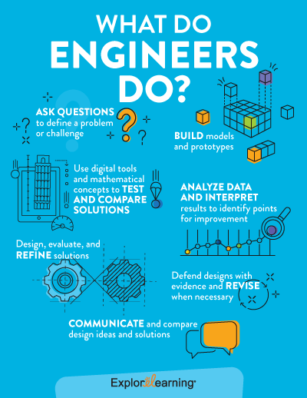

Slide 7
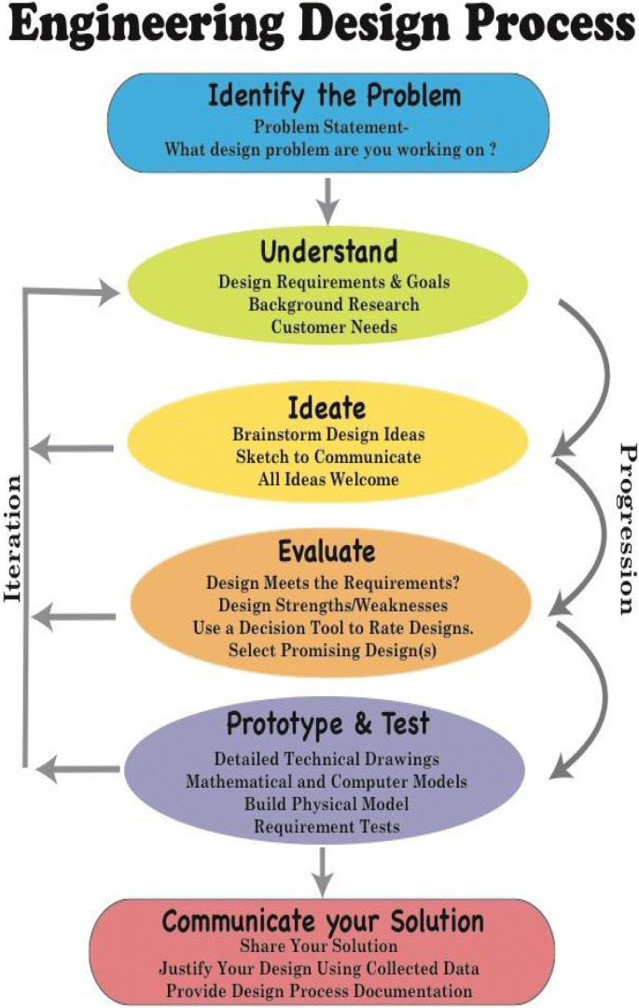

Slide 8
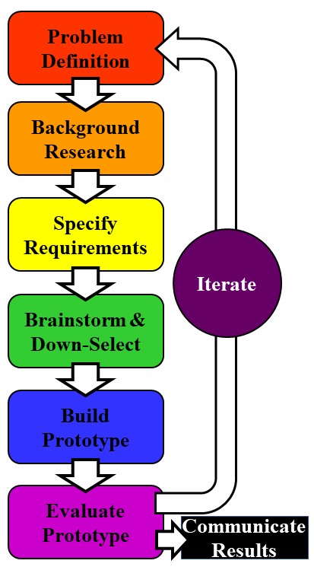

Slide 9
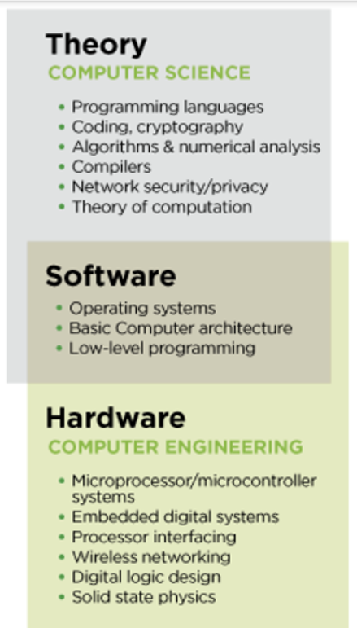

Slide 10
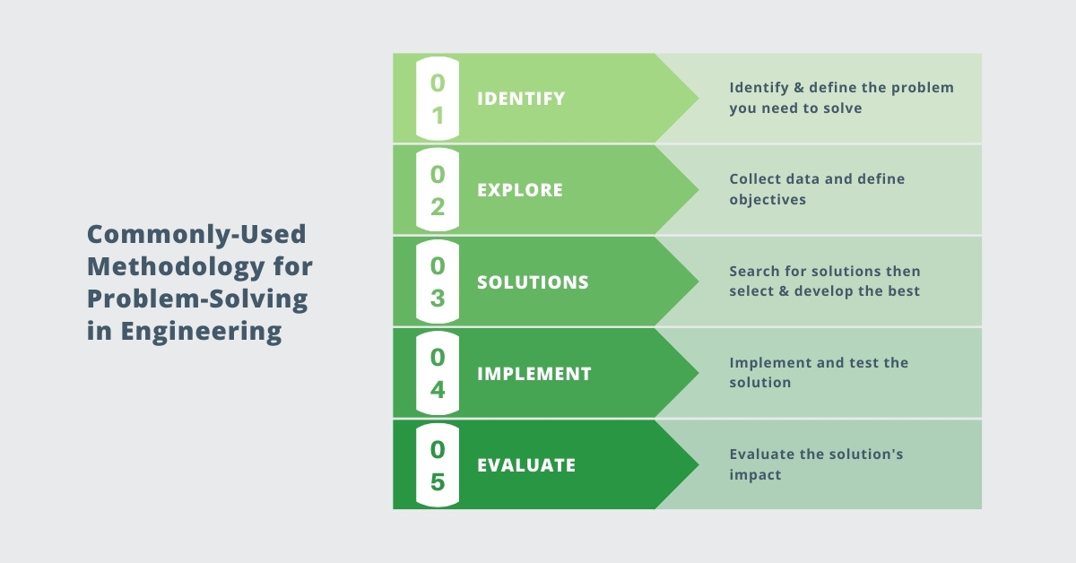

Slide 11
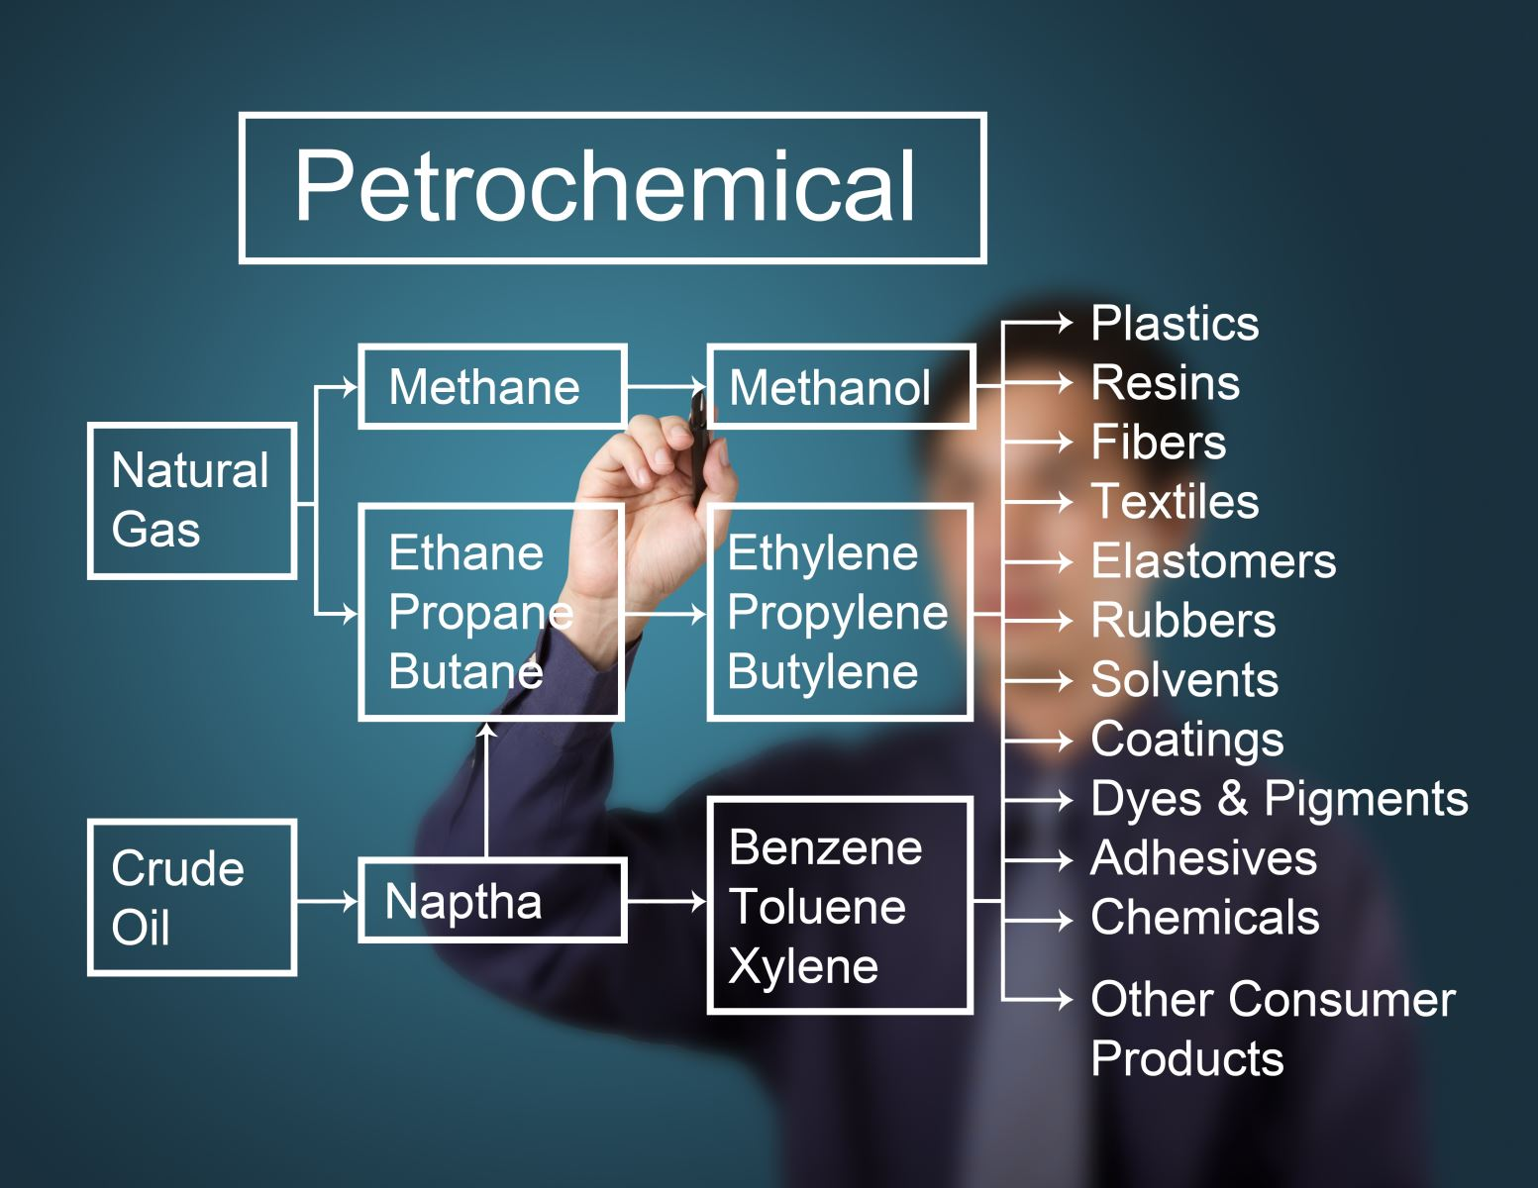

Slide 12
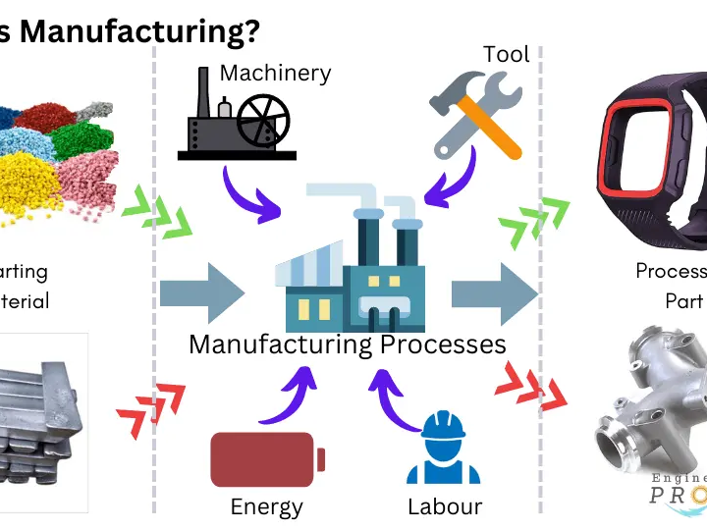

Slide 13

Engineering as a Discipline
Engineering as a discipline refers to a branch of academic study and systematic knowledge that applies scientific and mathematical principles to solve real-world problems.
Focus on problem-solving and innovation
It involves learning theories, developing technologies, designing systems, and innovating solutions to improve life.
Key branches:
Mechanical, Electrical, Civil, Chemical, Computer, etc.

Slide 14
Characteristics of Engineering Discipline
Interdisciplinary nature
Strong foundation in math and science.
Involves design, analysis, experimentation.
Emphasis on continual improvement and lifelong learning.

Slide 15
Key Components of Engineering as a Discipline
1. Scientific Foundation:
Engineers must understand the laws of nature—how forces act, how energy flows, and how materials behave. This knowledge comes from physics, chemistry, and biology.
2. Mathematical Modeling:
Mathematics is the language of engineering. Engineers use equations and formulas to model systems, predict outcomes, and optimize performance.

Slide 16
3. Design Thinking:
Engineering students are trained to think creatively and logically. They learn how to define a problem, brainstorm solutions, model and simulate designs, and improve systems through iteration.
4. Technical Knowledge:
Each branch of engineering whether it’s mechanical, electrical, civil, electronics, chemical, or computer has its own technical core. Students dive deep into specialized subjects relevant to that field.

Slide 17
5. Experimentation and Analysis:
Labs and experiments help engineers validate theories. They collect data, analyze results, and understand how things work in real-world scenarios.
6. Innovation and Research:
Engineering as a discipline encourages innovation developing new materials, creating energy efficient systems, improving manufacturing processes, and advancing technology through research.

Slide 18
Examples in Academic Context:
A mechanical engineering student learns about thermodynamics, machine design, and manufacturing processes.
An electrical engineering student studies circuit theory, electromagnetism, and signal processing.
A computer science student explores algorithms, programming languages, artificial intelligence, and data structures.

Slide 19
Engineering as a Profession
Engineering as a profession goes beyond classroom learning—it is the practical application of engineering knowledge to design, develop, operate, and maintain systems, products, and processes that serve the needs of society.
A professional engineer takes on real-world challenges and works to solve them responsibly, ethically, and efficiently.
Application of engineering knowledge for societal benefit.
Licensed and regulated by professional bodies (e.g., IEEE, ASCE, NEC).
Career-oriented focus: roles in industry, government, and consultancy.

Slide 20
Key Elements of Engineering as a Profession
Application of Knowledge:
Engineers use the theories and principles learned during their academic training to solve problems in industries such as construction, manufacturing, energy, healthcare, information technology, and transportation.
Example: A mechanical engineer designs an energy-efficient HVAC system for a hospital using thermodynamics and fluid flow principles.

Slide 21
2. Professional Responsibility:
Engineering is not just about solving technical problems; it also involves making decisions that affect people, property, and the environment. Engineers are trusted to act in the public interest.
Example: A structural engineer must ensure a building is safe, sustainable, and compliant with regulations—lives may depend on it.

Slide 22
3. Ethics and Integrity:
Professional engineers follow a code of ethics, which includes honesty, accountability, fairness, and respect for others. They must avoid conflicts of interest, ensure transparency, and always prioritize safety over profits.
Example: An engineer must refuse to certify a faulty design, even under pressure from management, if it compromises safety.

Slide 23
4. License and Certification:
In many countries, engineers are required to obtain a professional license (e.g., PE – Professional Engineer) to legally practice and sign off on projects. This ensures they have the competence and experience needed to perform critical work.
Example:
In India, an engineer working on a government infrastructure project—such as the design and approval of a national highway—must often be a Chartered Engineer (CE) registered with the Institution of Engineers (India) [IEI]. This certification validates their professional competence and allows them to sign technical documents, drawings, and certifications required by government agencies and regulatory bodies like the CPWD, Indian Railways, or NHAI.
In the United States, a civil engineer must obtain a Professional Engineer (PE) license to approve structural designs for public infrastructure like bridges or highways. Without this certification, they are not legally allowed to sign off on critical design documents submitted to government authorities for construction approval.

Slide 24
5. Teamwork and Communication:
Engineers often work in multidisciplinary teams, collaborating with architects, doctors, software developers, government bodies, and clients. Good communication and teamwork are essential to translate ideas into reality.
Example: A biomedical engineer works with surgeons to design a custom knee implant and explains the design choices in clear, simple terms.

Slide 25
6. Lifelong Learning and Innovation:
Technology and industry needs are constantly evolving. A professional engineer must continuously upgrade skills, learn about new tools, software, materials, and methods.
Example: An electrical engineer learns about AI and IoT to implement smart energy grids in urban planning.

Slide 26
Real-World Examples:
A civil engineer oversees the construction of a flyover, ensuring it’s strong enough to handle traffic loads and seismic forces.
A software engineer develops secure banking applications used by millions of people.
A chemical engineer in a pharmaceutical plant ensures that medicines are produced under safe and controlled conditions.
A renewable energy engineer designs and installs solar power systems to promote sustainability.

Slide 27
Comparison
Aspect | Engineering as Discipline | Engineering as Profession
Focus and Practice | Generation of Knowledge, theories, innovation and Research | Practical application of knowledge to solve real-world problems
Setting | Academic institutions, research labs, universities | Industries, corporate sectors, consultancy, government agencies
Output | Scientific theories, experimental results, conceptual designs | Functional products, infrastructure, processes, services
Goal | Advance the frontiers of science and technology | Ensure safety, efficiency, and service to society

Slide 28
Conclusion
Engineering bridges theory and practice
A discipline grounded in science and a profession rooted in service
Engineers shape the future through responsible innovation

Slide 29
Comparison
Aspect | Engineering as Discipline | Engineering as Profession
Focus and Practice | Generation of Knowledge, theories, innovation and Research | Practical application of knowledge to solve real-world problems
Setting | Academic institutions, research labs, universities | Industries, corporate sectors, consultancy, government agencies
Output | Scientific theories, experimental results, conceptual designs | Functional products, infrastructure, processes, services
Goal | Advance the frontiers of science and technology | Ensure safety, efficiency, and service to society

